Slide 1
JENKINS INTEGRATION WITH GITHUB AND BITBUCKET
Presenting by Murali Mohan

Slide 2
Trainer Introduction:
Name: Murali Mohan M
Current Organization : Genesis Tech Solutions Pvt.Ltd
Designation: DevOps Trainer
Training Experience : 3+ Years
Clients: Raxicube Technologies,ITonlineHub,Wipro
Mindtree,TutorzWorld,CorpAcademia..etc

Slide 3
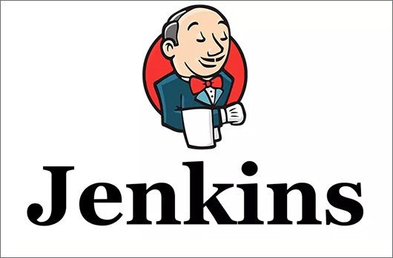

Slide 4
Jenkins Introduction
Jenkins is an open source automation server.
It helps automate the parts of software development related to building, testing, and deploying, facilitating continuous integration and continuous delivery.
It is a server-based system that runs in servlet containers such as Apache Tomcat.
Initial release date: 2 February 2011
Developer: Kohsuke Kawaguchi
Stable Release: 2.386 / 10 January 2023

Slide 5
What is Jenkins and why we use it?
Jenkins is an open-source automation tool written in Java with plugins built for continuous integration.
With Jenkins, organizations can accelerate the software development process through automation. Jenkins integrates development life-cycle processes of all kinds, including build, document, test, package, stage, deploy, static analysis, and much more.
When ever developers write code, We integrate all that code of all developers at that point of time and we build, test and deliver/deploy to the client. This process is called CI & CD.

Slide 6
Jenkins helps in achieving this.
So instead of doing night builds, build as and when commit occurs by integrating all code in SCM tool, build, test and checking the quality of that code is what Continuous Integration.
So in a day, there will be so many integrations, builds, tests & deliveries/deployments.
So bugs will be reported fast and get rectified fast. So development happens fast.
Jenkins achieves Continuous Integration with the help of plugins. Plugins allow the integration of Various DevOps stages. If you want to integrate a particular tool, you need to install the plugins for that tool.

Slide 7
Benefits of CI
Detect bugs as soon as possible.
If you want you can stop the SDLC process at any stage.
Eg: You can stop at test stage only or you can continue till deployment.
Maintains history (Logs) for reference

Slide 8
Why only Jenkins?
It has so many plug-ins.
You can write your own plug-in.
Jenkins is not just a tool. It is a framework. i.e. You can do what ever you want. All you need is plug-ins.
We can attach slaves(nodes) to Jenkins master. It instructs others(slaves) to do Job. If slaves are not available, Jenkins it self does the job.
Jenkins also acts as crone server replacement. i.e. can do repeated tasks automatically • Running some scripts regularly Eg: Automatic daily alarm.
Can create Labels (Can restrict where the project has to run).
You will be accessing Jenkins through web only.

Slide 9
What is GitHub
GitHub is one of the most popular resources for developers to share code and work on projects together.
It’s free, easy to use, and has become central in the movement toward open-source software.
GitHub is an online software development platform. It's used for storing, tracking, and collaborating on software projects.
It makes it easy for developers to share code files and collaborate with fellow developers on open-source projects. GitHub also serves as a social networking site where developers can openly network, collaborate, and pitch their work.
GitHub allows software developers and engineers to create remote, public-facing repositories on the cloud for free. A repository, or "repo" for short, is a coding project’s files and the revision history for each file.

Slide 10
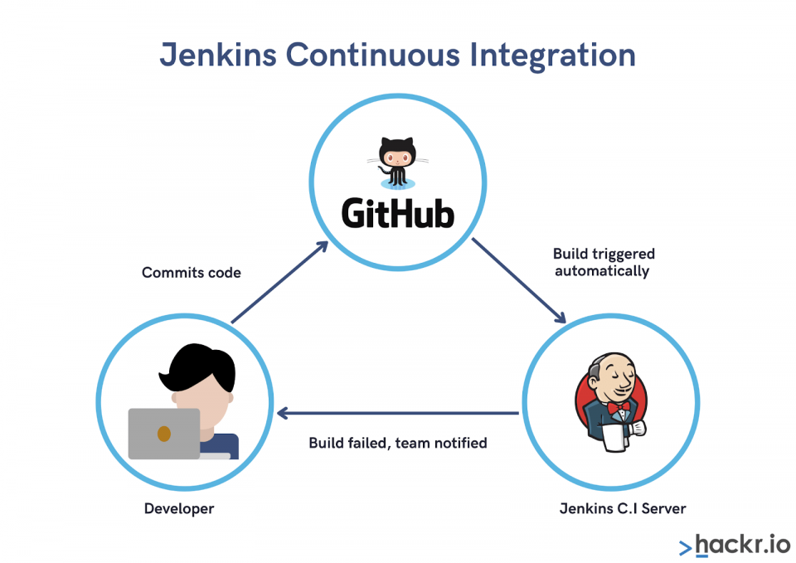

Slide 11
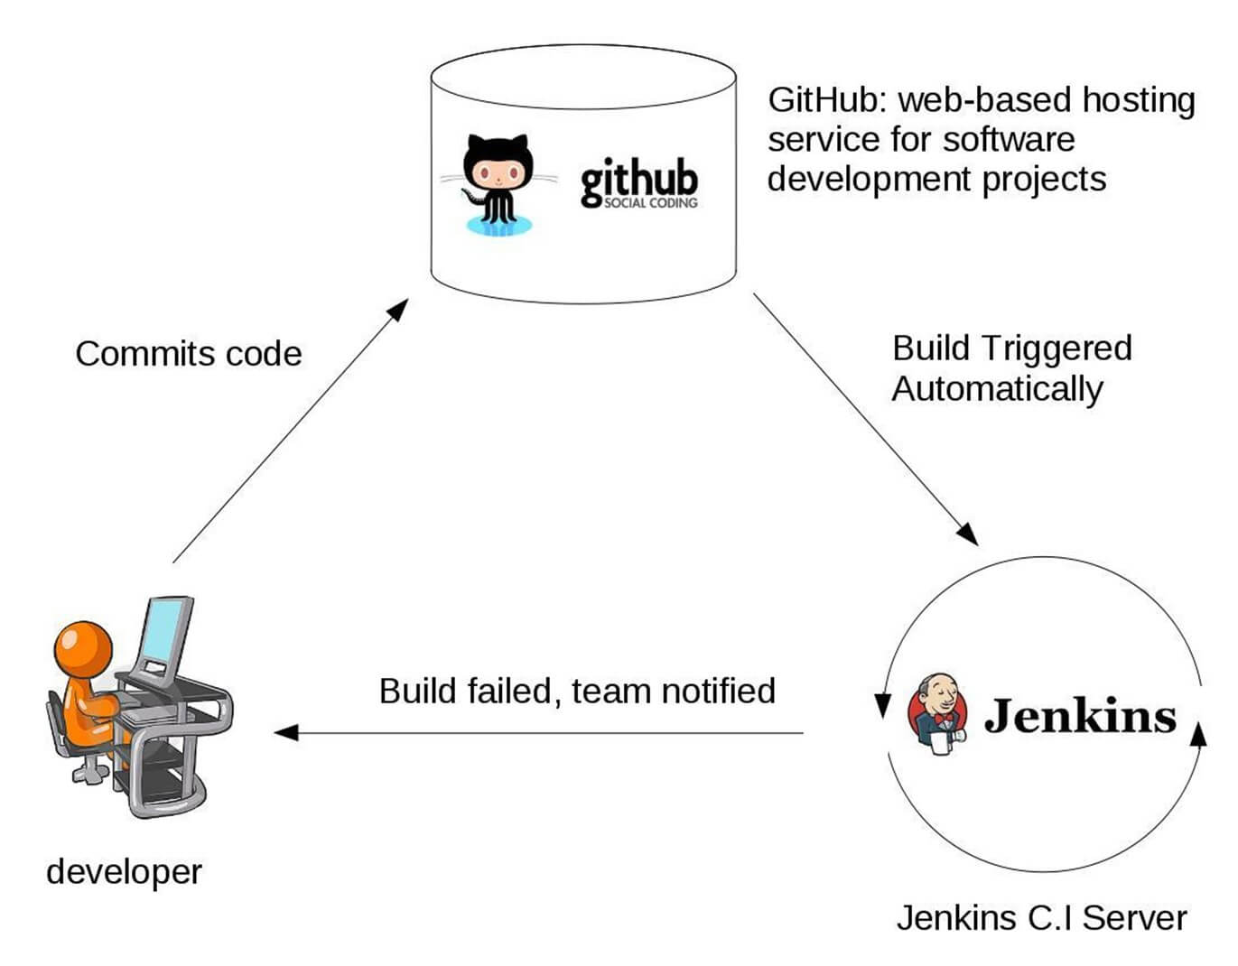

Slide 12
What is Bitbucket
Bitbucket is a Git-based source code repository hosting service owned by Atlassian. Bitbucket offers both commercial plans and free accounts with an unlimited number of private repositories.
It is also called as Git repository management software and is a central hub for handling all the Git repository. Uses of Bitbucket are access control, workflow control, pull request, and integration.
History view with branch comparison.
Manages branch permissions explicitly and allows the developer to restrict the branch access.
Allows third party API support

Slide 13
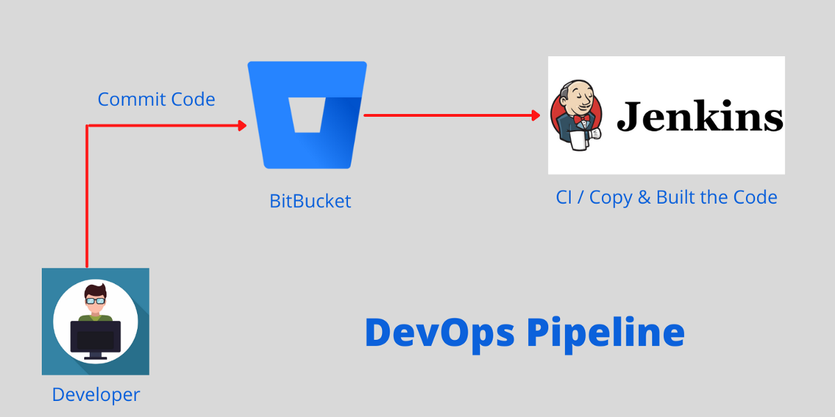

Slide 14


